Slide 1
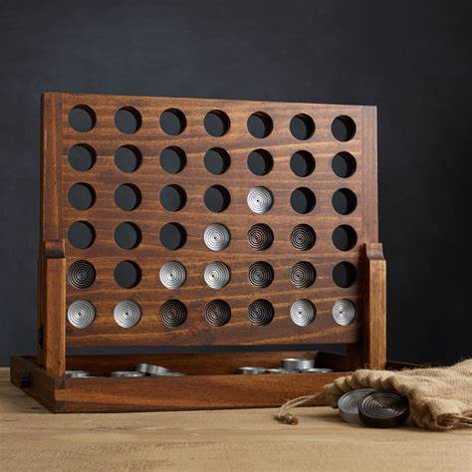
Four Connect
CS181 Final Project
章顺杰 罗天辰

Slide 2
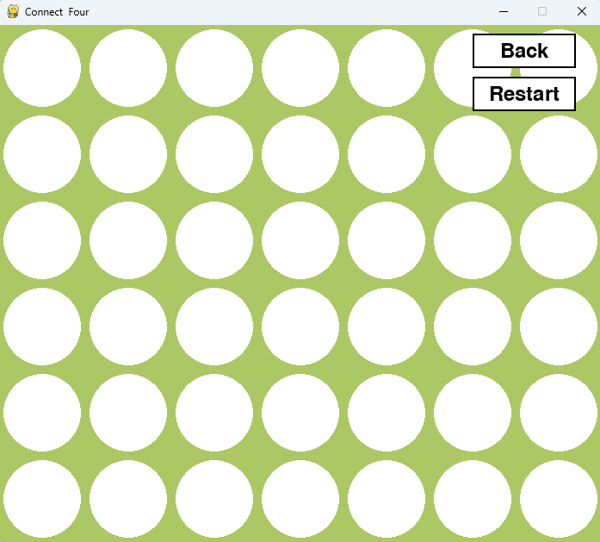
Settings
6*7 grids
3^42 ≈ 10^20 states
Larger board(9 * 9)
3^81 ≈ 10 ^ 38 states

Slide 3
Implement methods
Random
Greedy
Adversarial search (minimax, alpha-beta pruning)
Reinforcement learning
MCTS
Q-learning

Slide 4
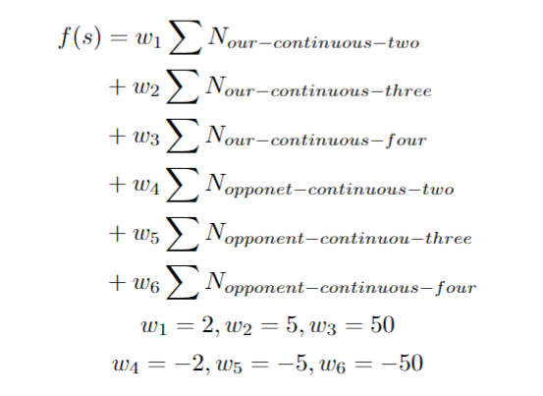
Basic methods
Random: randomly chose a column available each time
Greedy:
use a score function to evaluate each column, and chose the highest one

Slide 5
Basic methods
Adversarial search (minimax, alpha-beta pruning):
Similar method as taught in class, but we add more ending codition.
etc.
If the column can directly led to victory, or will make our next opponent win, there is no need to expand the game tree.

Slide 6
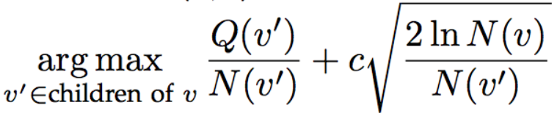
Monte-Carlo Tree Search
UCT
Exploitation
Exploration
we choose c = 1

Slide 7
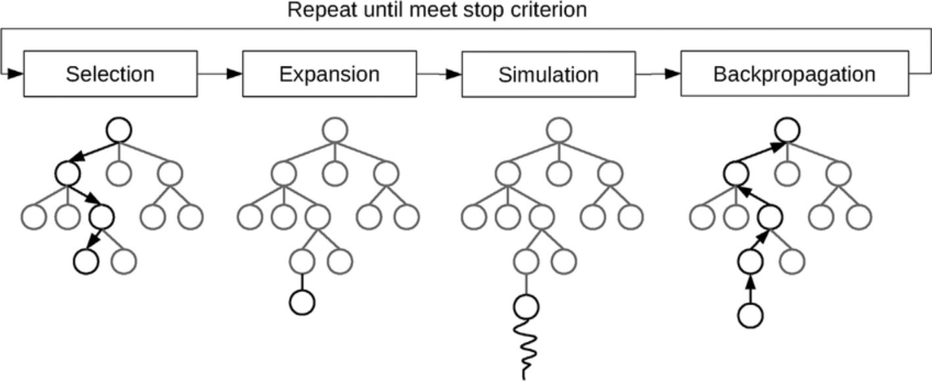
Monte-Carlo Tree Search
Also, instead of randomly simulation, we constrain the agents not to pick some obvously stupid action, elevating the speed of convergence.

Slide 8
Q-learning
choose：
get all the unfilled column
if training 10% (ε) radom choose
choose the hightest Q-Value colum
epsilon (ε=0.1)，
alpha (α=0.1)，
gamma (γ=0.95)
q_table： {state: {action: Q-Value}}
update_q_table:
Q(s,a) ← (1-α)Q(s,a) + α[r + γ·maxQ(s',a')]
get the next state biggest Q-Value

Slide 9
TRAINING
if episode > 0 and episode % 5000 == 0:
q_agent.epsilon = max(0.01, q_agent.epsilon * 0.95)
We reduce the epsilon (ε=0.1) every 5000 times .
and opponent_agent changed from radom to MiniMax.

Slide 10
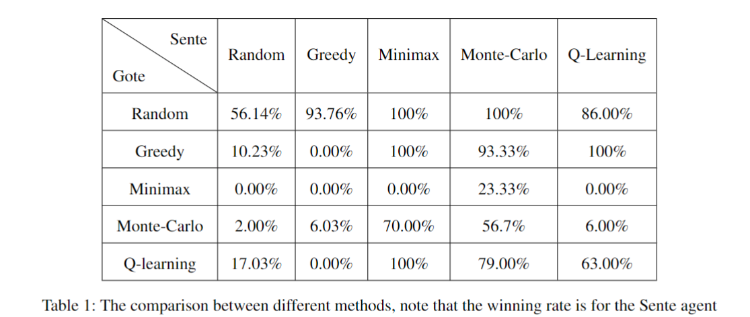
Results
Sente:先手
Gote :后手

Slide 11
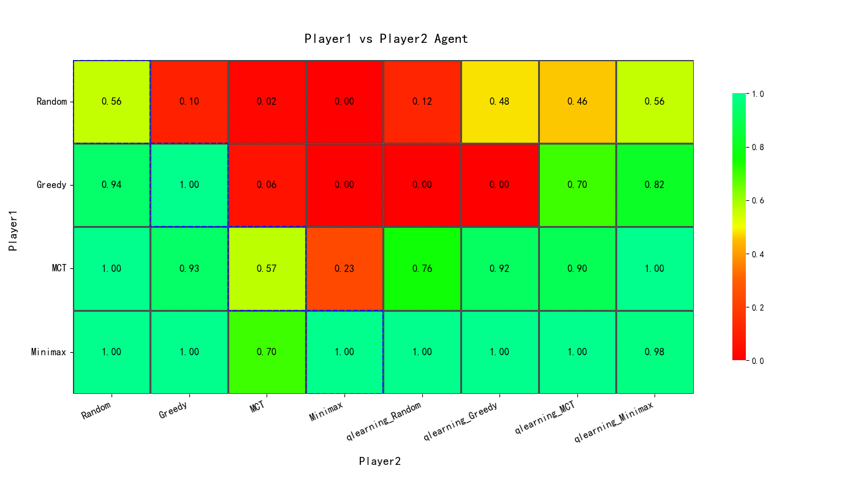
Results

Slide 12
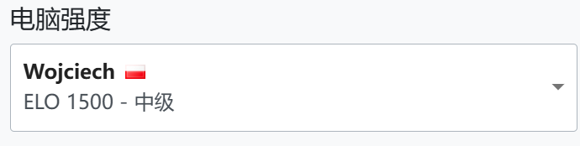
Results
Online AI:
Currently our Minimax Agents and MCT agents can reach a draw with meadian level AI online, but they can’t handle higher level.
Online Player:
After randomly picking 5 players online, our minimax won 5 out of 5 games, our MCT won 4 out of 5 games，our Qlearning_radom won 2 out of 5 games
game website:https://papergames.io/zh/%E5%9B%9B%E5%AD%90%E6%A3%8B

Slide 13
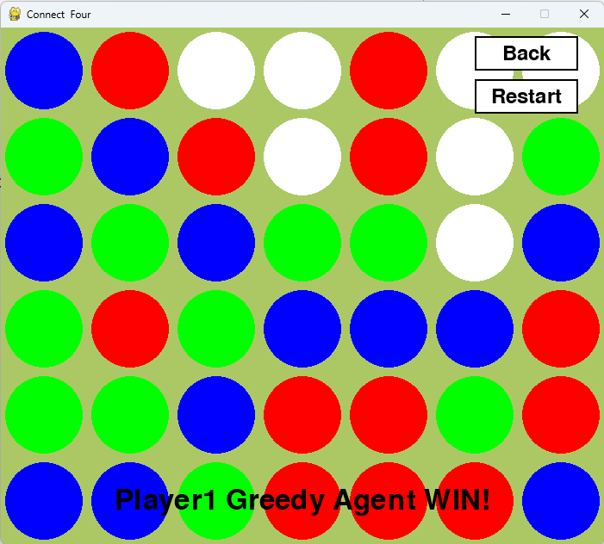
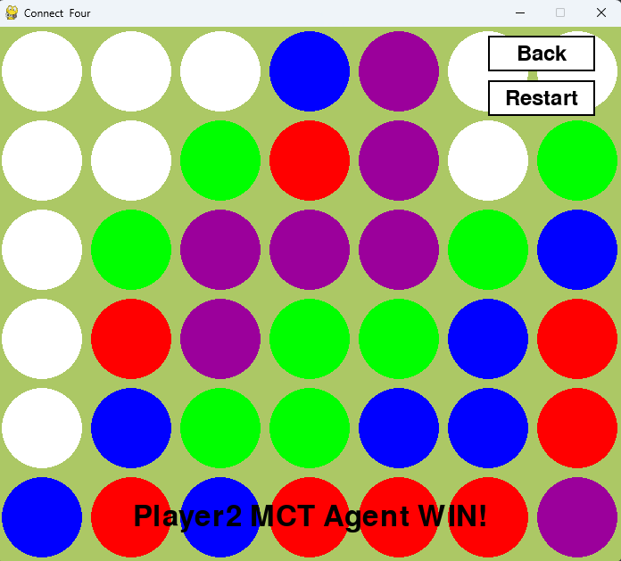
Extra Implementations
1V1V1 2V2

Slide 14
Extra Implementations
Use the agent we make ,
we can change the number of game players to realise
1V1V1 (the players Fighting on their own)
or 2V2 (the player who belongs to their team).

Slide 15
Thank you

